Slide 1

Beyond the Cure: Modeling the Risk of Breast Cancer Recurrence
Brandon Thomas

Slide 2
Project Overview
Purpose:
Create a model that allows clinicians to create a personalized treatment plan
Improve patient outcomes and enhance survivorship
Research Question(s):
What variables are most important in predicting breast cancer recurrence?
Can breast cancer be accurately predicted (relative) with the variables included in my dataset?

Slide 3
Data Description
Name | Data Type | Possible Values | Percent Missing Data (% of 286)
Class | Nominal | No-recurrence-events, recurrence-events | 0
Age | Ordinal | 10-19, 20-29, 30-39, 40-49, 50-59, 60-69, 70-79, 80-89, 90-99 | 0
Menopause | Nominal | lt40, ge40, premeno | 0
Tumor Size | Ordinal | 0-4, 5-9, 10-14, 15-19, 20-24, 25-29, 30-34, 35-39, 40-44, 45-49, 50-54, 55-59 | 0
Inv-Nodes | Ordinal | 0-2, 3-5, 6-8, 9-11, 12-14, 15-17, 18-20, 21-23, 24-26, 27-29, 30-32, 33-35, 36-39 | 0
Node-Caps | Nominal | Yes, no | 2.7972
Deg-Malig | Ordinal | 1, 2, 3 | 0
Breast | Nominal | Left, Right | 0
Breast-Quad | Nominal | left-up, left-low, right-up, right-low, central | 0.3497
Irradiat | Nominal | Yes, No | 0

Slide 4
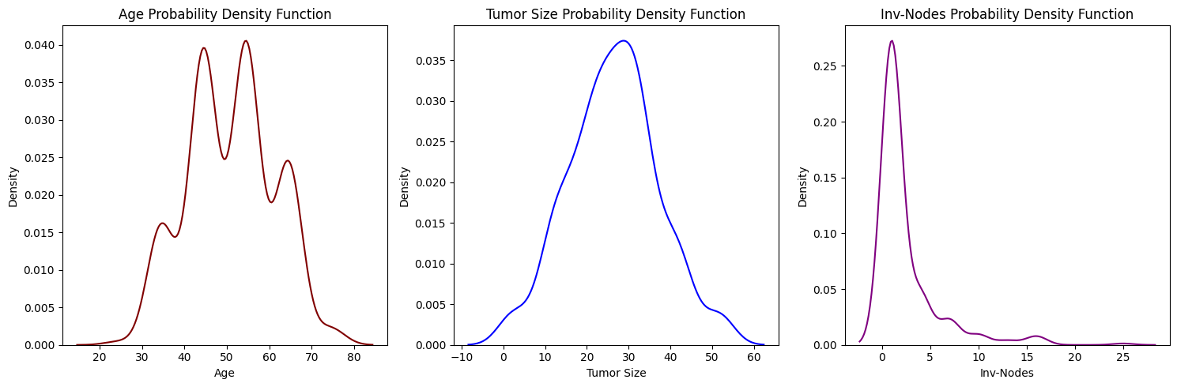
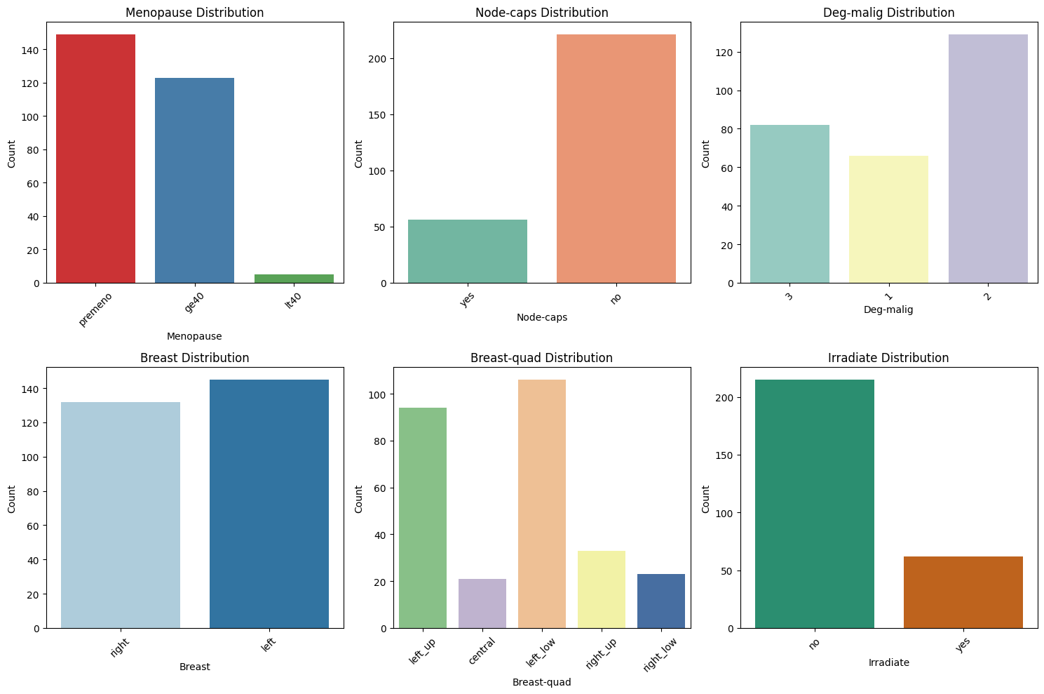
Exploratory Data Analysis (EDA)
Dataset from UCI Machine Learning Repository
Findings:
Class imbalance: far more non-recurrence cases than recurrence
Certain variables showed early signals of importance (e.g., tumor characteristics)
Correlation between features was generally low, reducing concerns of multicollinearity

Slide 5
Methods/Modeling
Models Used:
Linear Regression (baseline model)
XGBoost, Random Forest, SVM (classification models)
Preprocessing: Data cleaning, encoding categorical features, addressing imbalance with SMOTE
Evaluation Metrics: Accuracy, Precision, Recall, F1 Score

Slide 6
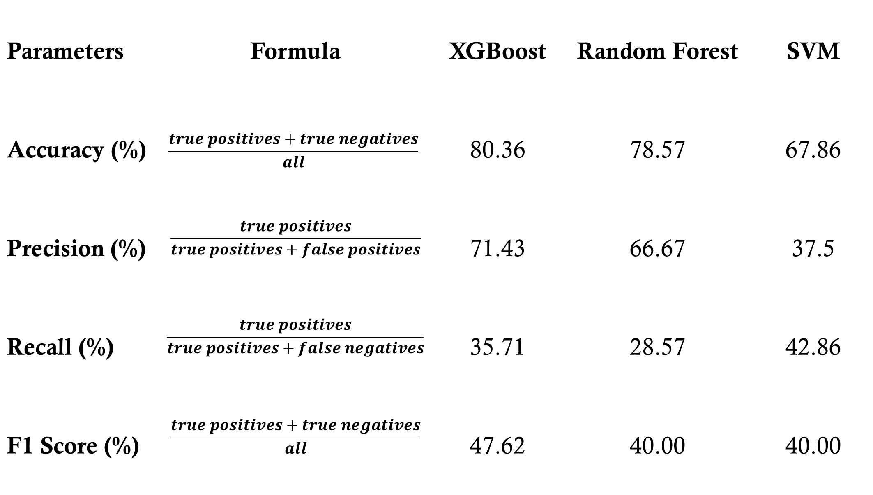
Preliminary Results
Linear Regression: Ineffective (R² ≈ 0)
XGBoost best performing model in all areas except recall

Slide 7
Final Results
XGBoost remained the best-performing model
Accuracy: 80.4%, Precision: 71.4%, Recall: 35.7%
Random Forest with SMOTE improved recall slightly (50%) but at a loss of precision
SVM still performed the worst across metrics
All models struggled with recall — identifying actual recurrence cases.

Slide 8
Conclusion/ Future Work
Conclusion
No model performed exceptionally well in recall, which is crucial for detecting cancer recurrence. A high number of false negatives could have severe consequences in a clinical setting.
XGBoost was the best-performing model overall, balancing accuracy and precision, though it still struggled with recall.
Random Forest showed some signs of overfitting, as indicated by the difference between cross-validation and test accuracy.
Future Work
Use advanced resampling techniques beyond SMOTE (ADASYN)
Continue feature engineering to find stronger predictors
Collect more balanced datasets for model validation

Slide 9
Reflection
Lessons Learned:
Importance of handling imbalanced datasets
Need for balancing multiple metrics (not just accuracy)
Value of model interpretability in clinical contexts
Challenges:
Recall was persistently low across models
Solutions:
Applied SMOTE; future work needed on more complex resampling and model optimization

Slide 10
Summary
Built models to predict breast cancer recurrence
XGBoost performed best but recall was weak across all models
Most important features are: the number of positive axillary lymph nodes detected, tumor size, the degree of malignancy, and age of the patient.
Future improvements: better data balance, advanced modeling techniques
Could potentially be used and scaled to inform personalized treatment plans for patients

Slide 11
Questions?

